Slide 1
Data Science
MSCI:6070 Spring 2017
Lecture 1 (1/23/17)

Slide 2
Course Overview (1)
Objective:
1. Learn the basics of data science, particularly data mining (predictive analytics)
2. Focus on building predictive models and finding patterns in data
Main topics:
Knowledge discovery process (CRISP-DM)
data cleansing & transformation, data visualization, model evaluation & comparison
Predictive modeling techniques
decision trees, logistic regression, support vector machines, k-nearest neighbors,
artificial neural networks, ensemble methods
Clustering
hierarchical clustering, K-means
Association rules and correlation analysis

Slide 3
Course Overview (2)
Textbooks
Data Science for Business: What you need to know about data mining and data-analytic thinking
F. Provost and T. Fawcett. O'Reilly, 2013
Data Mining with Rattle and R: The Art of Excavating Data for Knowledge Discovery
G. Williams. Springer, 2011
Software
R: http://www.r-project.org/
R Studio: http://www.rstudio.com/
Rattle: http://rattle.togaware.com/
Course materials
ICON (https://icon.uiowa.edu/)
Syllabus and Instructions for Installing R/RStudio/Rattle have been posted on ICON

Slide 4
Assignments and Exams
7 HW assignments 35%
1 Mid-term exam 30%
1 Final exam 30%
Class participation 5%
Assignments should be your individual work and submitted online through ICON
Late submissions subject to 10% penalty per day (up to 3 days)
A make-up exam can be requested in case of illness or any special circumstances
See syllabus for more details

Slide 5
Expectations
Attend lectures
Students are responsible for being aware of everything taught/announced in class
There will be in-class exercises to help improve understanding of lectures. Don’t miss them
Time commitment
Spend time reviewing lectures, reading textbooks, and doing homework
Only sitting in class does not help much
Finish assignments as required on time
Plan things ahead
Don’t wait until the last minute!
Travel plans, make-up exams, projects, homework

Slide 6
Contact Information
Email: wenjun-wang@uiowa.edu Please include “MSCI:6070” in your subject line
Phone: (319) 384-4927 (O)
Office: W250 Pappajohn Business Building, 21 E Market St, Iowa City
Office hours:
Before/after class in classroom
By appointment (on campus)
Post your question on ICON discussion
I will try to reply as soon as I can
Other students are welcome to discuss and reply
No disclosure of homework answers!

Slide 7
Question?

Slide 8
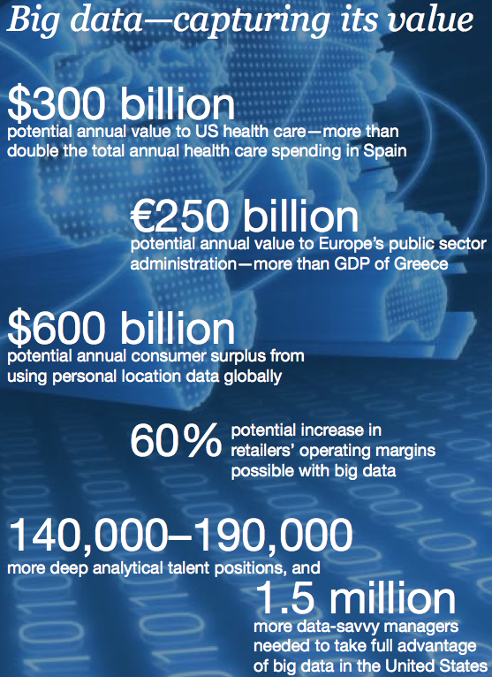
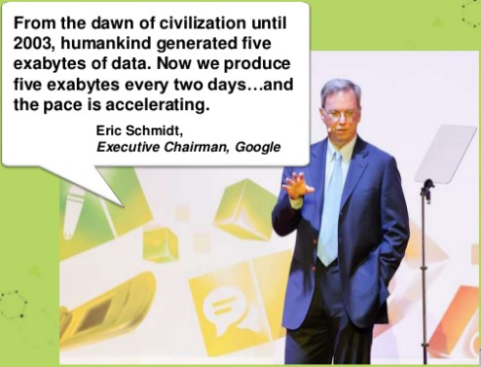
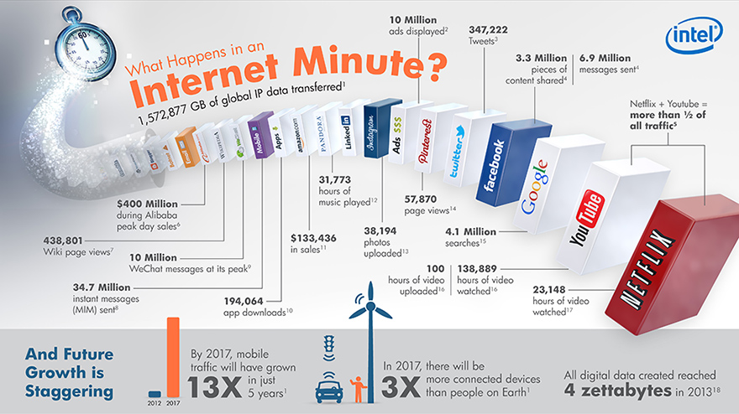
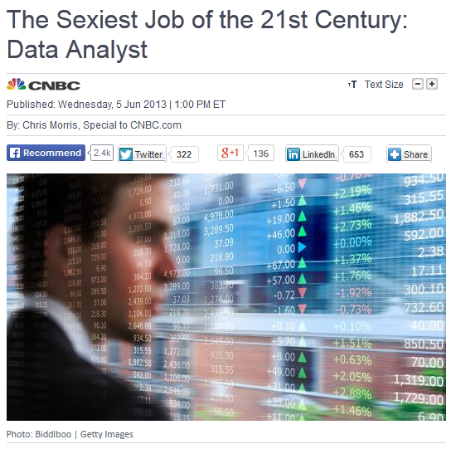
Big Data and Big Value
Sources: Intel. http://www.intel.com/content/www/us/en/communications/internet-minute-infographic.html

Slide 9
Data-centric Business
is involved in
Decision
Making
triggers
User
is used in
stores and
maintains
Knowledge
Actions
Web sites
is the
basis of
Sales
is used to
produce
Data
Information
Advertising
Logistics
Corporate Data Cycle

Slide 10


Data-Analytic Thinking
The value of a company is essentially the value of the data it captures
Target: targeted marketing using big data
Customer purchase history
Extract information predicting which customers are pregnant
Make special offers before their competitors
Amazon: Recommendation System
Association rule mining
Discover customers’ buying patterns/preference to maximize purchase opportunity
Example: Predicting Customer Churn
Can you reduce/prevent it? → need to predict it and send retention offer in advance
How to predict/identify? → data mining techniques to find the characteristic patterns

Slide 11
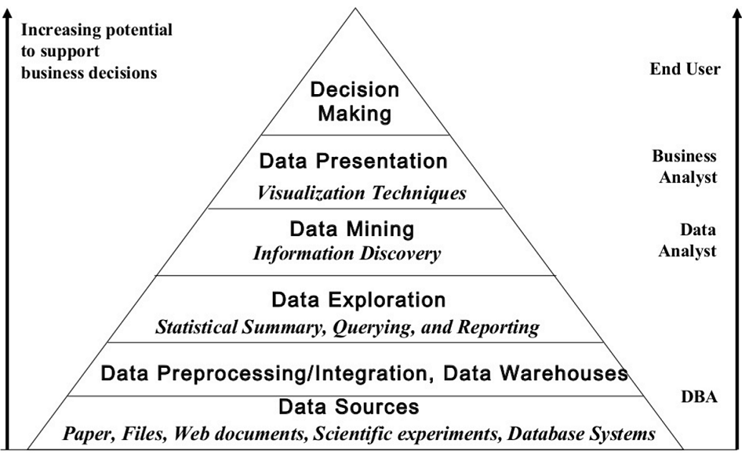
Data-Driven Decision-Making

Slide 12
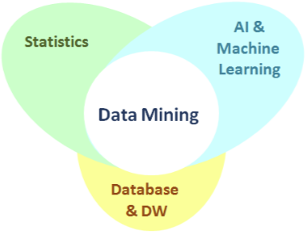
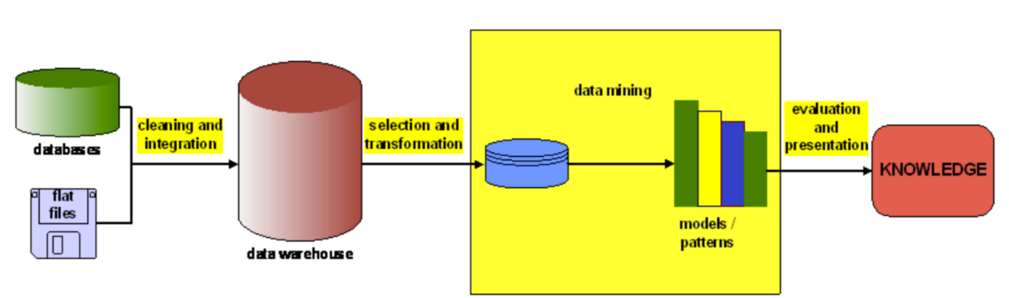
Data Mining
The process to extract useful information and knowledge from data
It was an integral part of knowledge discovery in databases (KDD)
It is an interdisciplinary field of statistics, AI & machine learning, and database
Definition: the nontrivial process of identifying valid, novel, useful and ultimately understandable
patterns in data

Slide 13
Data Mining Tasks
Two Major Categories:
Different Types:
Classification
Regression
Similarity matching
Clustering
Co-occurrence grouping
Profiling
Link prediction
Data reduction
Causal modeling
Predictive tasks
Predict the value of a particular attribute
-- target/dependent variable
Based on the values of other attributes
-- explanatory/independent variables
Descriptive tasks
Derive patterns that summarize relationships
-- correlations, trends, clusters, anomalies, etc.
Require validation and interpretation of the results

Slide 14

Task 1: Classification
A (small) set of pre-specified classes/labels
-- it is usually a categorical (nominal) variable
e.g. “will churn” or “will not churn” for the customer-churn prediction
Goal: for each individual in a population, predict which class this individual belongs to
Output: a predictive model
A closely related task: class probability estimation
Probability = 0.8
Probability = 0.2

Slide 15
Task 2: Regression
A numeric variable of interest for a population
e.g. “how many data will a given customer use over his/her cell phone?”
Goal: estimate the numerical value of that particular variable specific to each individual
Output: a predictive model (for value estimation)
Related to classification but different: -- classification: whether something will happen
-- regression: how much something will happen
Data usage = 10 GB
Data Usage = 300 MB

Slide 16

Task 3: Similarity Match
Some particular individual(s) of interest (as target)
e.g. “the existing most profitable customers of a company”
Goal: identify similar individuals based on data know about them
Output: a predictive model (for targeted similarity search)
Application: -- product recommendation
(find people who are similar in term of their purchase history and product preference)

Slide 17
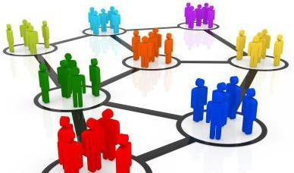
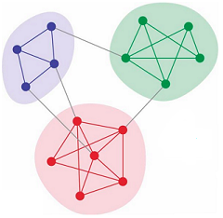
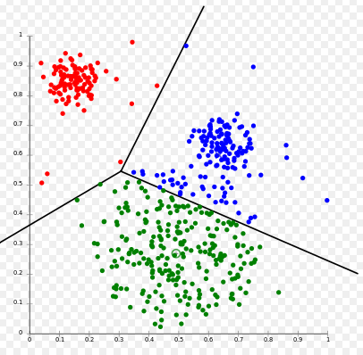
Task 4: Clustering
Based on similarity (closeness), but unsupervised
i.e. no specific target variables or individuals
Goal: group individuals in a population into different clusters such that:
individuals in the same cluster are more similar to each other than individuals in other clusters
Output: a descriptive model
Application: -- marketing: customer groups by consumer tastes/behavior
-- social networks: communities of users densely connected

Slide 18
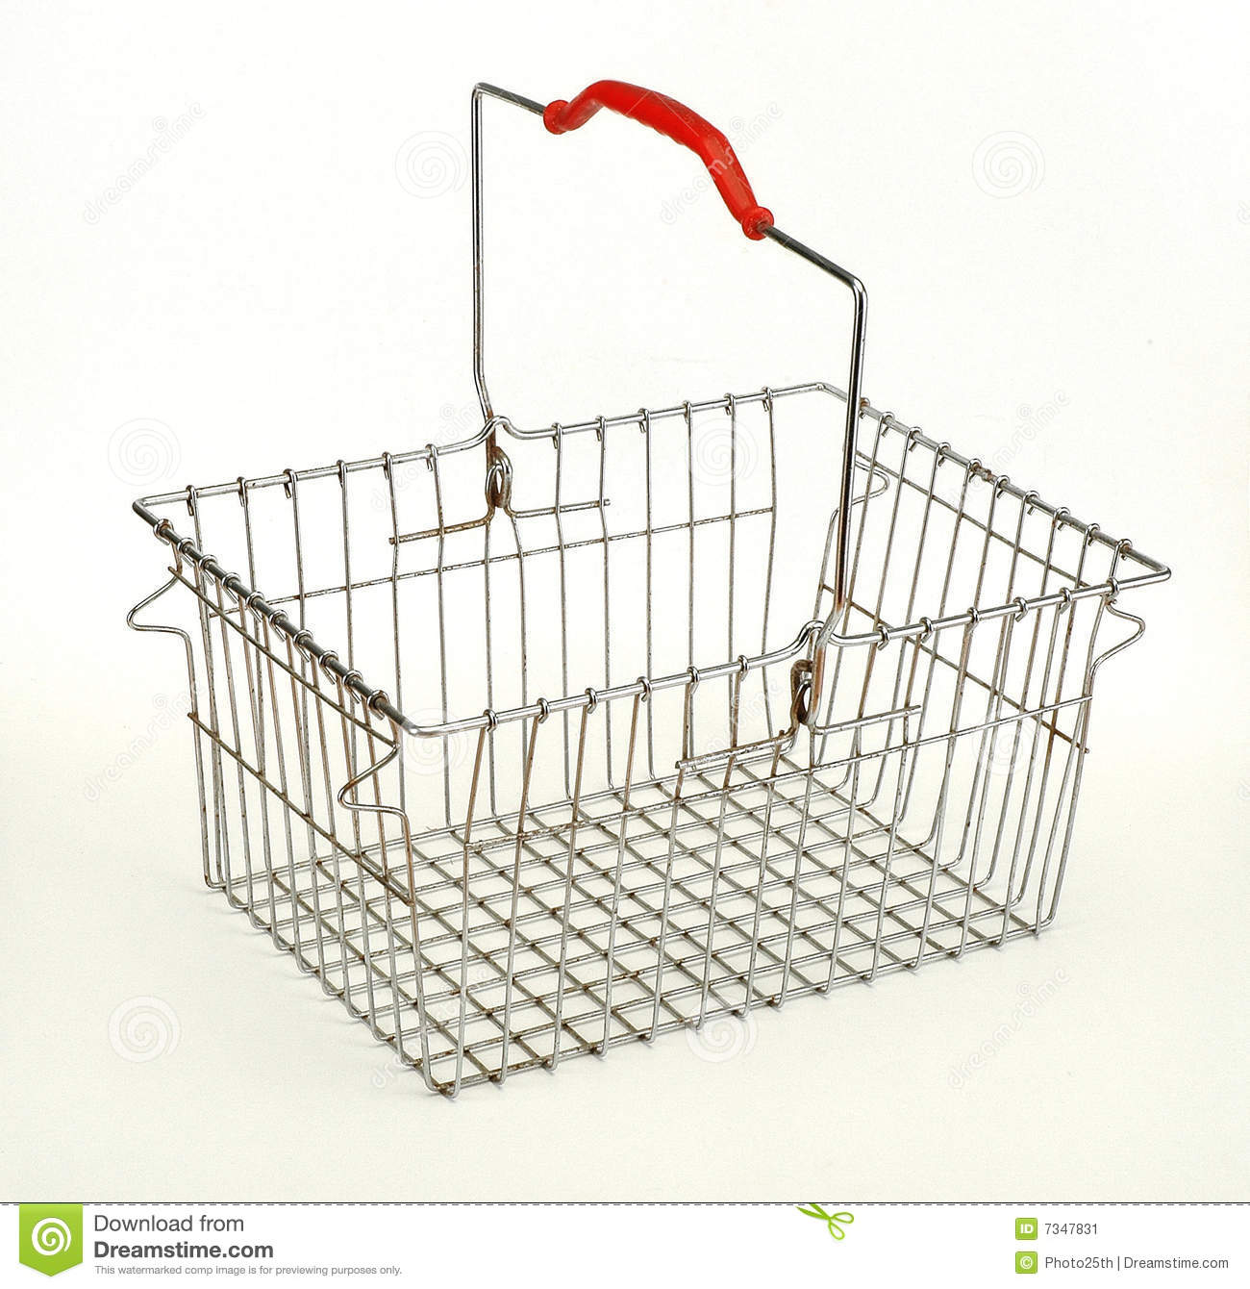
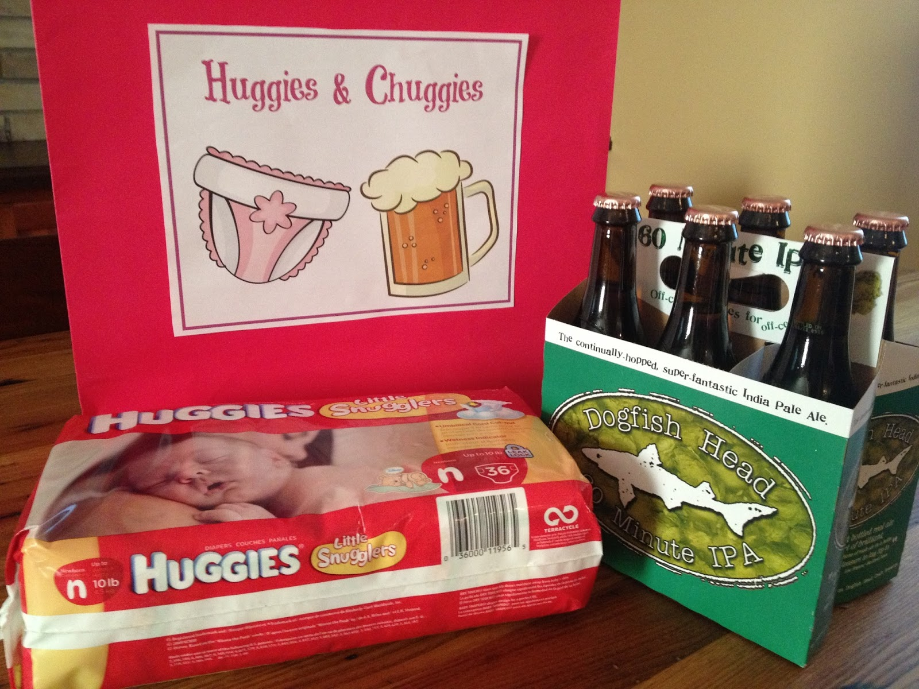
Task 5: Co-occurrence Grouping
aka – frequent itemset mining, association rule discovery, market-basket analysis
Goal: find associations between entities based on transactions involving them
(products frequently purchased together)
Output: a descriptive model
Application: -- marketing: increase revenue
-- recommendation systems

Slide 19
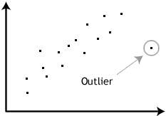
Task 6: Profiling
aka – behavior description
Goal: characterize the typical behavior of an individual, group, or population
(establish behavioral norms)
Output: a descriptive model
Application: -- fraud detection (monitoring fraudulent charges of one’s credit card)
-- anomaly detection (terrorist)

Slide 20


Task 7: Link Prediction
Goal: predict the connections between
data items (objects of interest)
Output: a predictive model
-- suggest a link should exist,
-- estimate the strength of the link
Application:
-- social network analysis
B
A
E
C
D

Slide 21



Task 7: Link Prediction
Goal: predict the connections between
data items (objects of interest)
Output: a predictive model
-- suggest a link should exist,
-- estimate the strength of the link
Application:
-- social network analysis
-- recommender systems
P1
M1
P2
M2
M3

Slide 22
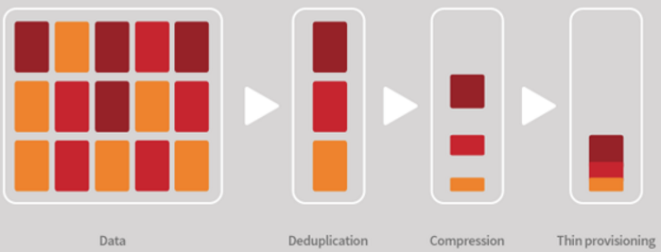
Task 8: Data Reduction
Goal: replace a large set of data with a smaller set of data that
contains much of the important information in the larger data set
Benefits: -- easier to store and process
-- better to reveal patterns
Disadvantage: -- loss of information (trade off)
Note: it is different from
dimension reduction,
which reduces the number of attributes by feature selection and feature extraction

Slide 23
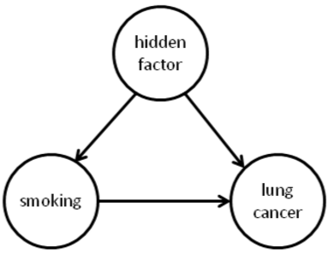
Task 9: Causal Modeling
Goal: find out what events/attributes/actions lead to (influence) others
(i.e., causal mechanism/effect)
Involve: -- randomized controlled experimentation
-- sophisticated methods for drawing causal conclusions
Note: it is different from
correlation or co-occurrence.
Correlation between A and B does not imply A leads to B or vice versa,
e.g., the size of a person’s palm w.r.t how long he or she will live

Slide 24
Supervised vs. Unsupervised
Key question:
-- Is there a specific, quantifiable target
we are interested in or trying to
predict?
Supervised learning
-- YES, a specific target is provided
-- require a set of “labeled” training data
e.g. whether a customer will churn
when her contract expires?
Unsupervised learning
-- NO target information is provided
e.g. Do our customers form groups?
Task | Unsupervised | Supervised
Classification |  | ✔
Regression |  | ✔
Similarity matching | ✔ | ✔
Clustering | ✔
Co-occurrence grouping | ✔
Profiling | ✔
Link prediction | ✔ | ✔
Data reduction | ✔ | ✔
Causal modeling |  | ✔

Slide 25

Data Mining Process
Cross Industry Standard Process for Data Mining (CRISP-DM)
Business understanding
Data understanding
Data preparation
Modeling
Evaluation
Deployment
Note: Data mining is an iterative learning process

Slide 26
CRISP-DM
Phase 1: Business Understanding
Understand the problem to be solved
What are the objectives and requirements?
What is the use scenario?
How to cast the business problem as DM tasks?
Problem formulation
(key to success)

Slide 27
CRISP-DM
Phase 2: Data Understanding
Raw material from which the solution will be built
What data do we need?
What data is available?
Is the data related to the business problem?
Is the data complete and reliable?
Is it a supervised or unsupervised DM task?
If it is supervised, do we have data on the target?
Need to check with Business Understanding back and forth

Slide 28
CRISP-DM
Phase 3: Data Preparation
Most time-consuming step (90% of the time)
Real-life data are usually dirty
Cleaning: data entry errors, missing values, outliers, etc.
Selection: data points/records, attributes
Consolidation: integration of data from multiple sources
Construction: create new variables (more informative)
Transformation: data types, rescaling, etc.
Be aware of “leaks”: a variable gives info on the target

Slide 29
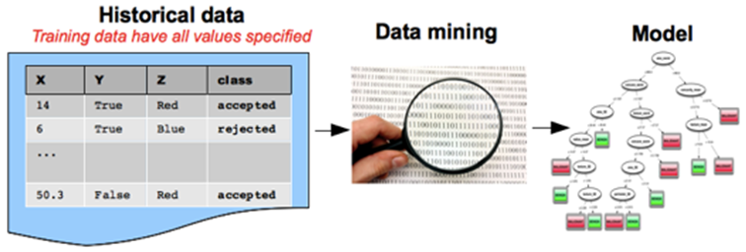
CRISP-DM
Phase 4: Modeling
Select the appropriate modeling techniques
Calibrate the parameters to optimal vales
This is the Fun part ☺

Slide 30
CRISP-DM
Phase 5: Evaluation
Equally important as the Modeling phase
Assess the model rigorously (valid and reliable)
How well does it perform on training data
How well does it perform on testing data
-- overfitting (discuss later)
How well doe it solve the original business problem?
There should be an arrow going back from EVALUATION to MODELING

Slide 31
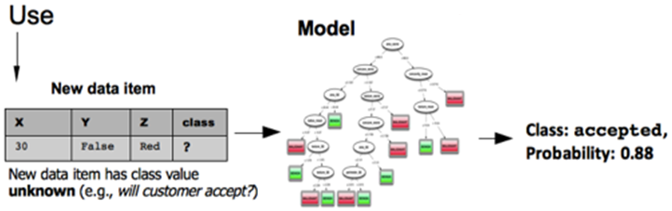
CRISP-DM
Phase 6: Deployment
Put into real use in the business
Determine to deploy the results or model or DM system
There is important distinction between MODELING and DEPLOYMENT

Slide 32
Recap of Data Preparation
Dataset
A collection of data represented in terms of a two-dimensional table/matrix
Each row corresponds to an observation (aka. record, entity, instance, data point)
Each column represents a variable (aka. attribute, field, feature)
Features/Attributes
(Input variables)
Target Variable
(class/label)
Identifier Attribute
Date | Temperature | Wind Direction | Evaporation | Rain?
10 Dec | 23 | NE | 10.4 | Y
10 May | 21 | NW | 2.6 | N
… | … | … | … | …
instance/
record/
observation

Slide 33
Recap of Data Preparation
Types of Data
Numeric variables: aka quantitative variables, e.g., age (integer), height (real number)
Categorical variables: aka qualitative variables
-- take on a single value from a fixed set of possible values
-- nominal (no order), e.g., gender (F/M), color(red/green/blue)
-- ordinal (natural order), e.g., air quality (excellent/good/poor), letter grade (A/B/C)
numeric
numeric
categorical
categorical
Date | Temperature | Wind Direction | Evaporation | Rain?
10 Dec | 23 | NE | 10.4 | Y
10 May | 21 | NW | 2.6 | N
… | … | … | … | …

Slide 34
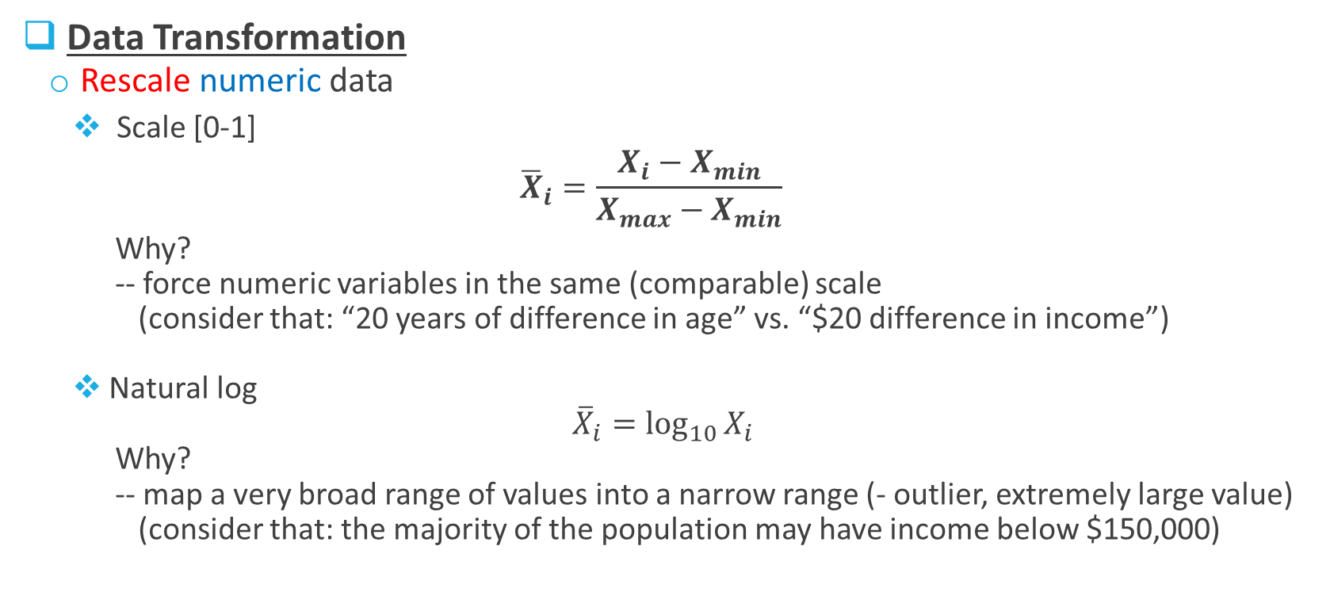
Recap of Data Preparation
Data Transformation
Rescale numeric data
Scale [0-1]
$${\overline{X}}_{i}=\frac{X_{i}−X_{min}}{X_{max}−X_{min}}$$
Why?
-- force numeric variables in the same (comparable) scale
(consider that: “20 years of difference in age” vs. “$20 difference in income”)
Natural log
$${\overline{X}}_{i}=\log_{10}{X_{i}}$$
Why?
-- map a very broad range of values into a narrow range (- outlier, extremely large value)
(consider that: the majority of the population may have income below $150,000)

Slide 35
Recap of Data Preparation
Data Transformation
Binarize of categorical data
Two steps: 1. m categorical values → interval [0, m-1]
2. convert each of these m integers to a binary number
Color | Integer Value | x1 | x2
Red | 0 | 0 | 0
Blue | 1 | 0 | 1
Green | 2 | 1 | 0
Air Quality | Integer Value | x1 | x2 | x3
Aweful | 0 | 0 | 0 | 0
Poor | 1 | 0 | 0 | 1
OK | 2 | 0 | 1 | 0
Good | 3 | 0 | 1 | 1
Great | 4 | 1 | 0 | 0
Note: the order must be maintained for the ordinal variable

Slide 36
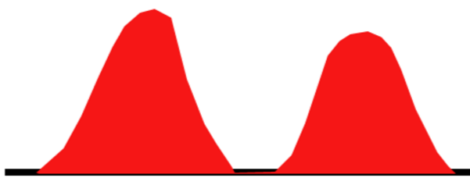
Recap of Data Preparation
Data Cleaning
Remove bad values (e.g., height = 10 feet, age = 205)
Remove outliers (in most cases)
Fill missing values (with mean/median/mode or a global constant such as “0” or “unknown”)
Isn’t it absurd?
Yes – it turned out the unit was changed from centimeters to inches for a part of the dataset
That is why we need to explore the data, and look into it carefully
Height distribution of a large group of adults in a city

Slide 37
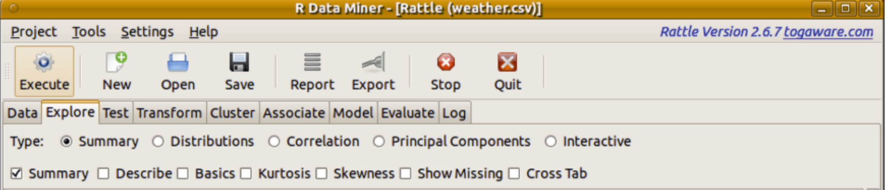
R and Rattle
R
A sophisticated statistical software package (http://www.r-project.org/)
-- easy to install, state-of-the art, free and open source
Install package: Install.packages(“packagename”)
Load package: library(packagename)
Rattle
A powerful DM tool built on R (http://rattle.togaware.com/)
Run Rattle: rattl()

Slide 38
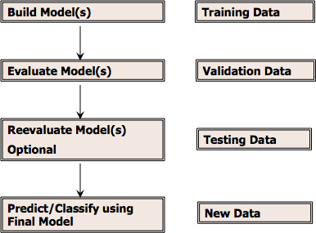
Data Partitioning
Data available to us when we build a model
Deployment

Slide 39
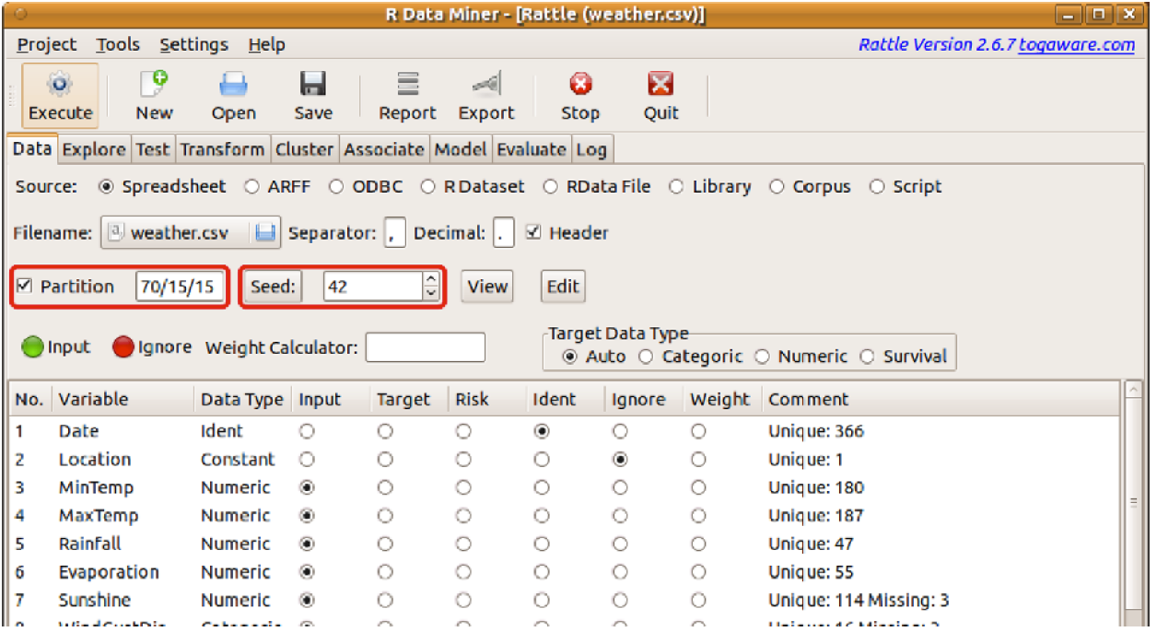
Data Partitioning

Slide 40
Visualizing Distribution
For numeric attributes:
Box Plot
Histogram
For categorical attributes:
Bar Plot
Dot Plot
Mosaic Plot
Scatter Plots

